Slide 1
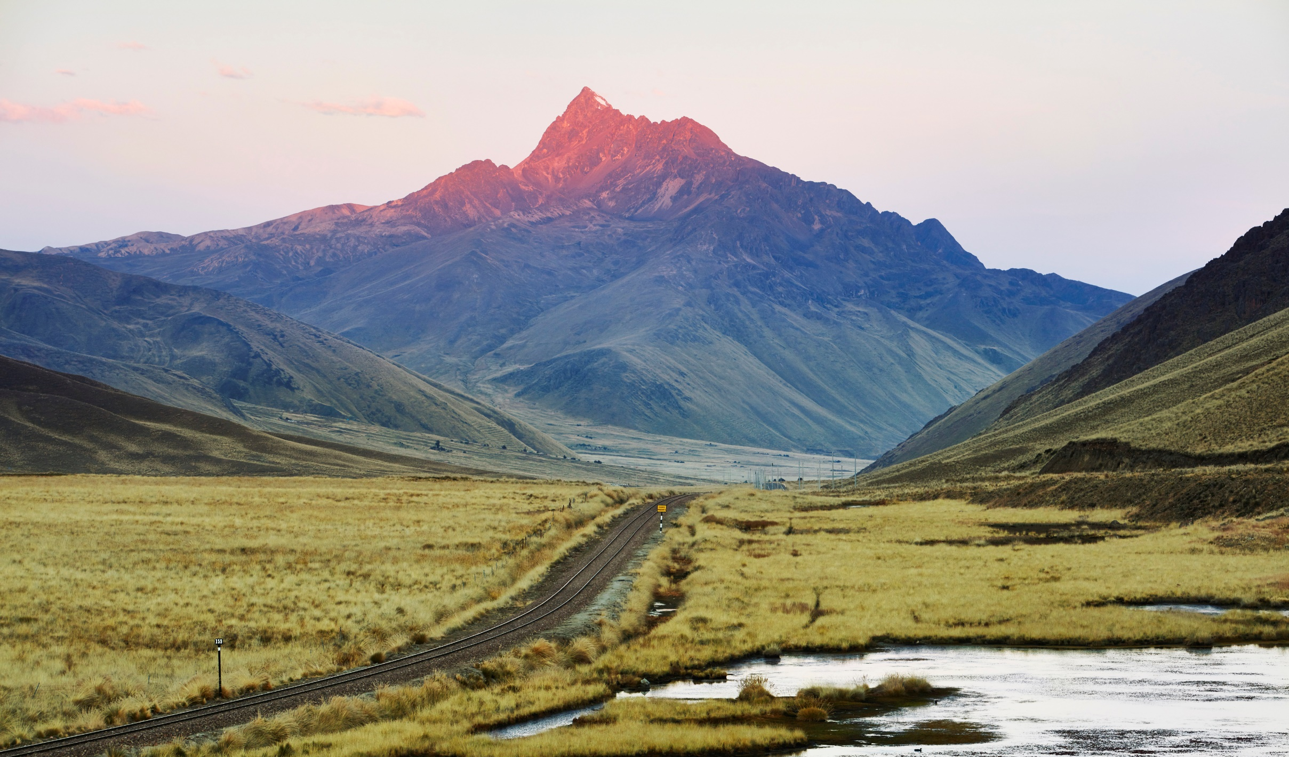
One history,
a thousand
inspiring
stories.

Slide 2
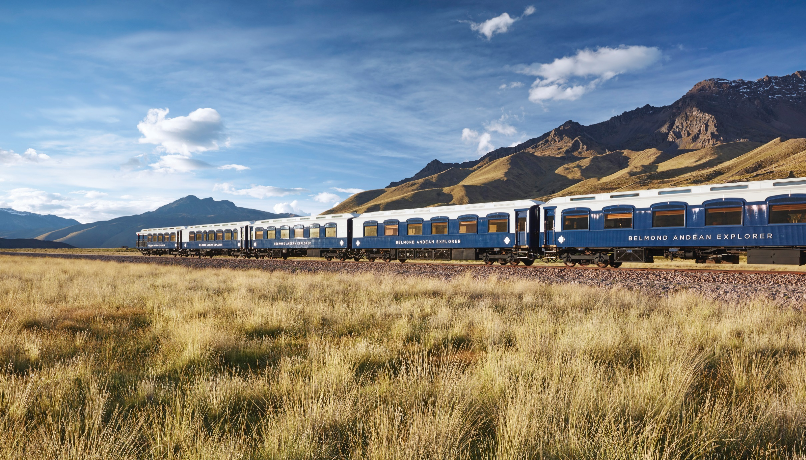
Andean Explorer,
A Belmond Train
Puno – Cusco - Arequipa

Slide 3
Andean Explorer
Route

Slide 4
Andean Explorer
Journeys
Spirit of the Water Spirit of the Andes Peruvian Highlands
Andean Plains

Slide 5
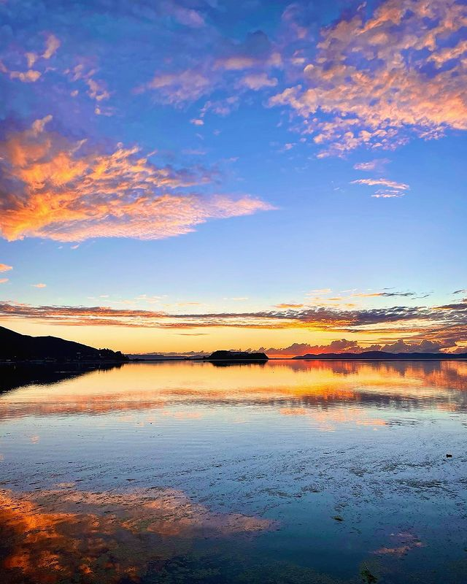
Spirit of
the Water
1 night: Cusco - Puno
Day 1 - Tuesday
Day 2 - Wednesday
11:00
12:30
13:55
15:30
17:45
19:00
19:30
23:30
Departure from Cusco, Wanchaq Station
Lunch on board
Tour of Raqchi
Afternoon tea on board
Tour of La Raya
Pre-dinner Cocktails Dinner on Board
Arrive at Puno,
Titicaca Lake Station
Overnight stay at Puno,
Titicaca Lake Station
Sunrise at Titicaca Lake
06:00
08:30
12:30
15:45
16:00
16:50
19:30
Breakfast on board Board boats to explore
Lake Titicaca Lake
Private lunch at
Collata Beach, Taquile,
Dance & artisanal craft displays
Arrive back at Titicaca Lake Station
Depart to Arequipa
Pre-dinner cocktails Dinner on board

Slide 6
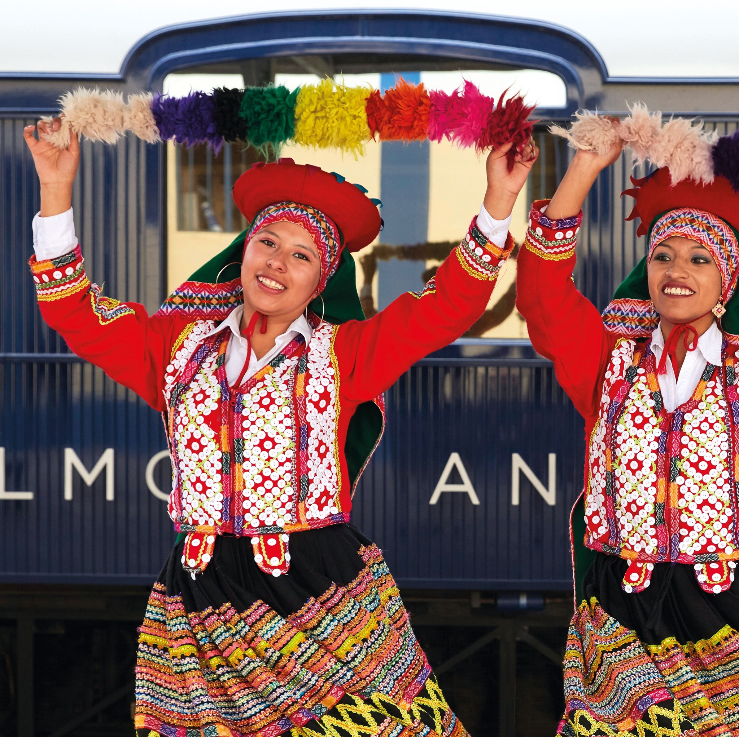
Spirit of
the Andes
1 night: Puno – Cusco
Day 1 - Wednesday
Day 2 - Thurday
12:00
13:15
18:00
19:00
19:30
21:00
Depart from Puno,
Lake Titicaca Station
Lunch on Board
Tour of La Raya
Pre-dinner cocktails
Dinner on board
Arrive at Cusipata (Cusco)
Overnight stay at Cusipata (Cusco)
05:30
06:00
07:35
Depart to Cusco
Breakfast on board
Arrival to Cusco,
Wanchaq Station

Slide 7
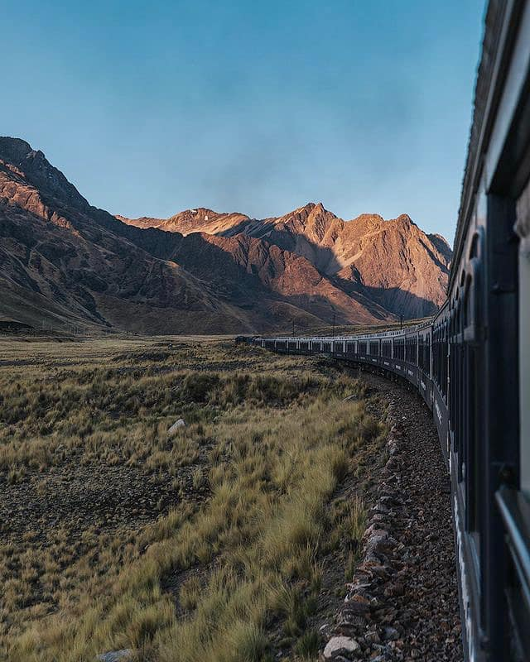
Peruvian
Highlands
2 nights: Cusco – Puno – Arequipa
Day 1 - Thursday
Day 2 - Friday
Day 3 - Saturday
11:00
12:30
13:55
15:30
17:45
19:00
19:30
23:30
Departure from Cusco Station
Lunch on board
Visit to Raqchi
Tea time
Sunset at La Raya
Cocktail
Dinner on board
Arrival to Titicaca Lake Station
Sunrise at Titicaca Lake
06:00
06:45
11:30
12:30
15:30
16:00
15:30
Breakfast on board
Depart to Arequipa
Station Km. 93:
Passengers going independently to Colca Canyon disembark*
Light lunch on board
Arrive at Arequipa Station
Airport transfer with panoramic views
Arrive at Arequipa airport
06:00
08:30
12:30
15:45
16:00
16:50
19:30
Breakfast on board Board boats to explore Titicaca Lake
Private lunch at Collata Beach,Taquile,
Dance & artisanal craft displays
Arrive back at Lake Titicaca Station
Depart to Arequipa
Pre-dinner cocktails
Dinner on board

Slide 8
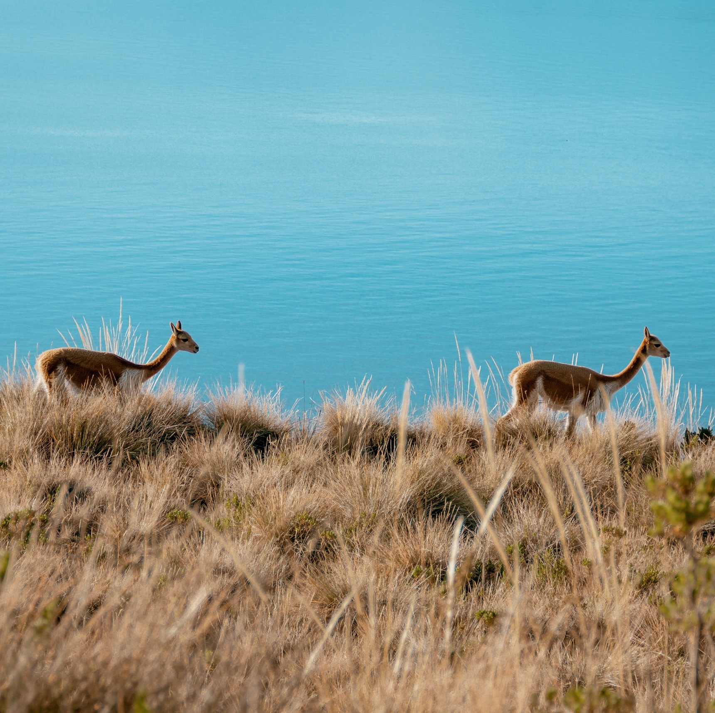
Andean Plains
& Islands of discovery
2 nights: Arequipa – Puno – Cusco
Day 1 - Saturday
Day 2 - Sunday
Day 3 - Monday
19:00
20:00
20:30
Welcome cocktail at Arequipa Station
Depart from Arequipa Station
Dinner on board
Overnight on board on route (train moving during the night)
Sunrise at Titicaca Lake
Sunrise at Marangani
06:00
08:30
12:30
15:45
16:00
16:50
19:30
Breakfast on board Board boats to explore Titicaca Lake
Private lunch at Collata Beach,Taquile,
Dance & artisanal craft displays
Arrive back at Lake Titicaca Station
Depart to Cusco
Pre-dinner cocktails
Dinner on board
Arrival & overnight
at Marangani
06:00
07:30
08:30
11:30
13:15
Breakfast on board
Depart to Cusco
Tour of Raqchi
Light lunch on board
Arrival at Cusco,
Wanchaq Station

Slide 9
About
Andean Explorer
Price | Recommendation
Departures:
time a week
Duration
day and 1 day itinerary available
Stops:
Itinerary dependable
Roundtrip:
Available
Overnight:
Onboard

Slide 10
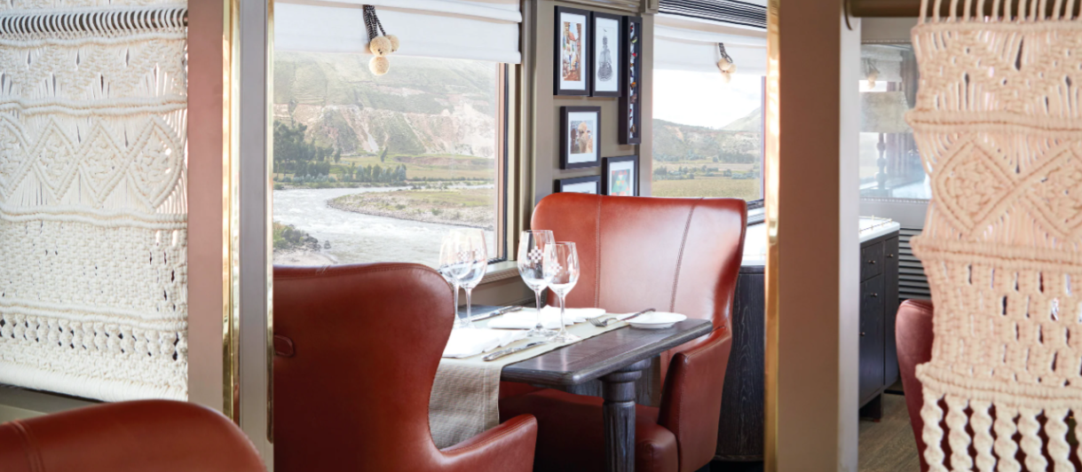
About
Andean Explorer
Andean Explorer is the first luxury train in South America.
It travels one of the highest train routes in the world, crossing impressive cities, from Cusco to Puno.
Marks a departure from classic vintage luxury, instead evoking a contemporary aesthetic perfectly designed to frame the awe-inspiring Andean landscape.

Slide 11
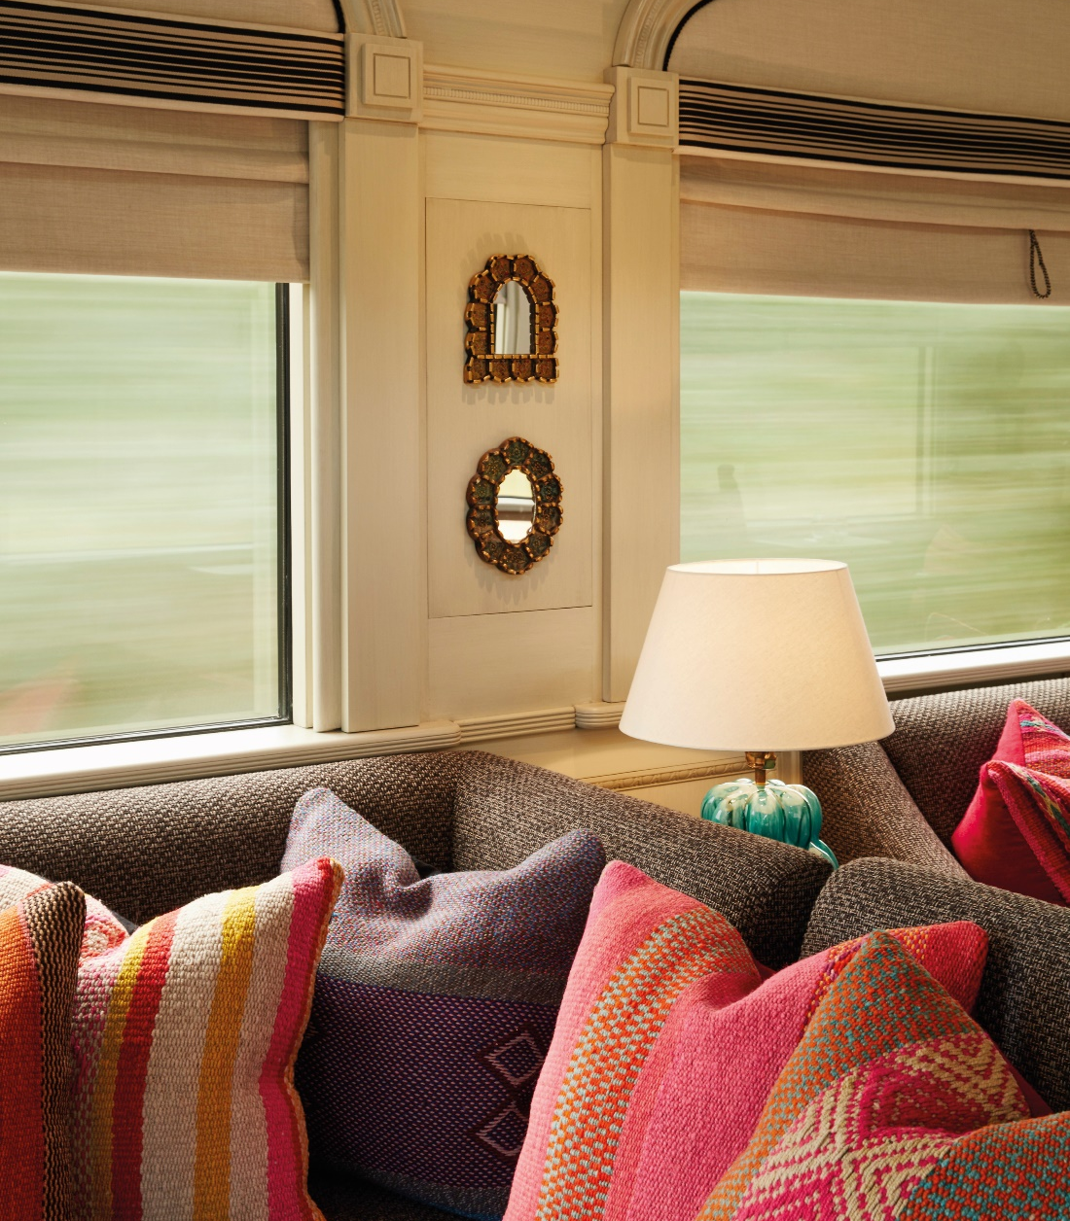
Key Selling
Points
First overnight luxury train in South America.
Flexibility to start the journey in Cusco, Puno or Arequipa (4 routes).
Exclusive trip to explore the south of the country: Puno and Arequipa, with highlight in Lake Titicaca.
Outdoor experiences captures the best of the
Peruvian attractions.
An awarded route, recognized for the beauty of its landscape; from magnificent Cusco to the highest navigable lake in the world, finalizing in the majestic Arequipa, a world heritage site.

Slide 12
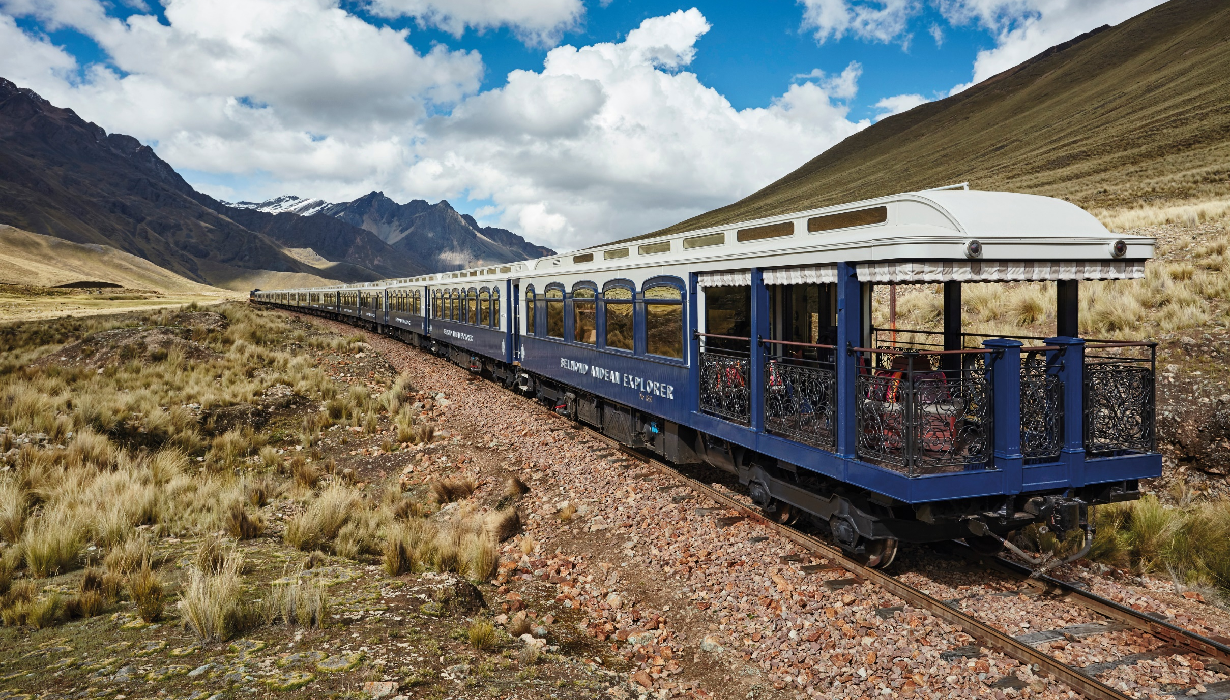
17 Cars in total
35 cabins
2 Dining Cars (22 / 28 passengers)
Observation Car (20 passengers)
Lounge Car (25 passengers)
Bar Car (12 passengers)
Spa Car (3 individual cabins)
9 Suite Cabins (2 passengers)
17 Twin Bed Cabins (2 passenger)
9 Bunk Bed Cabins (2 passengers)
The Convoy

Slide 13
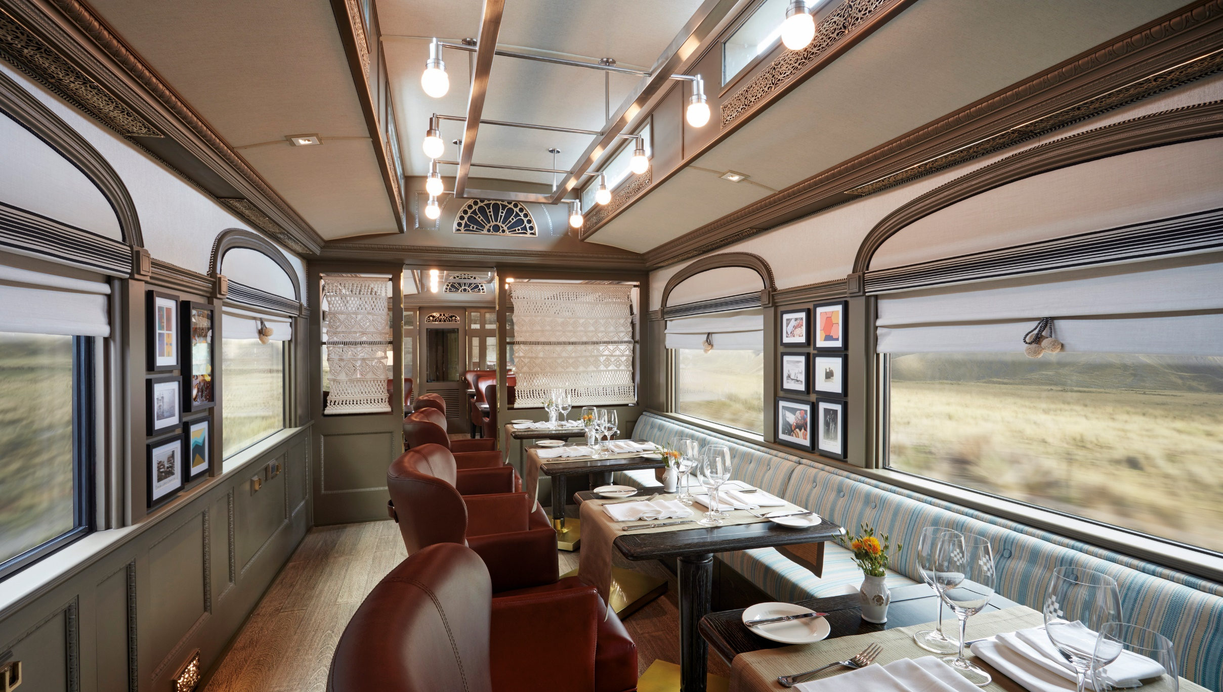
Dining Car.
Take a seat for a world-class feast in the train’s two beautiful dining carriages—Llama and Muña. Bright and elegant, each atmospheric space is the perfect setting for gastronomic discovery.
Up to max. of 32 px. With a waiters station and the open area (3 saloons)

Slide 14
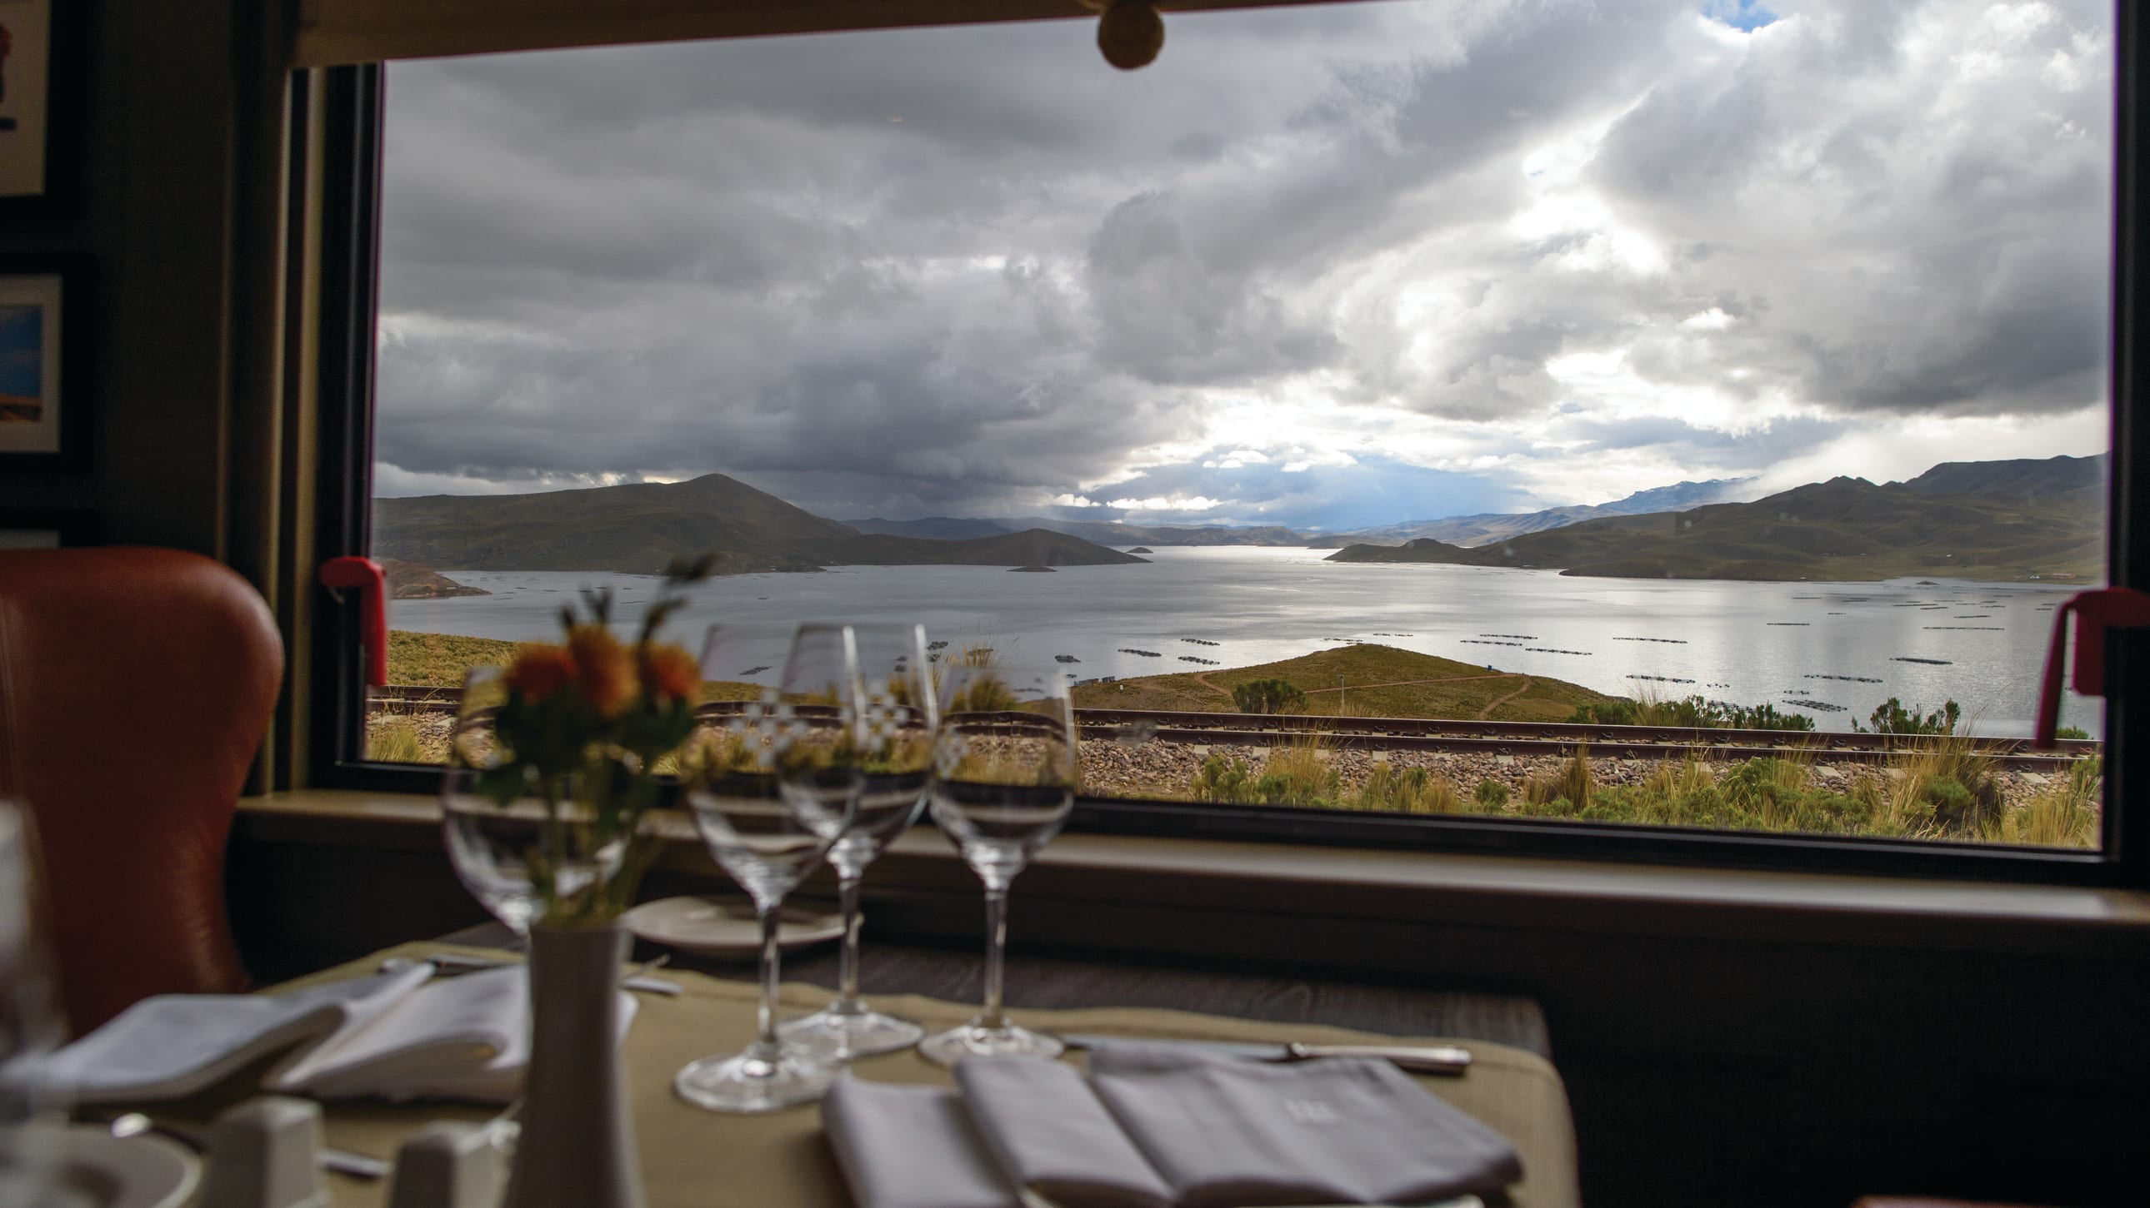
Dining Car.

Slide 15
Dining Car/Boutique.
Has the same features as the Dining Carriage, except the seating capacity is 22 pax in one sitting comprising of 4 tables x 4 places and 3 tables x 2 places within an open area divided into 2 saloons. At one end occupying one saloon area is the Boutique.

Slide 16
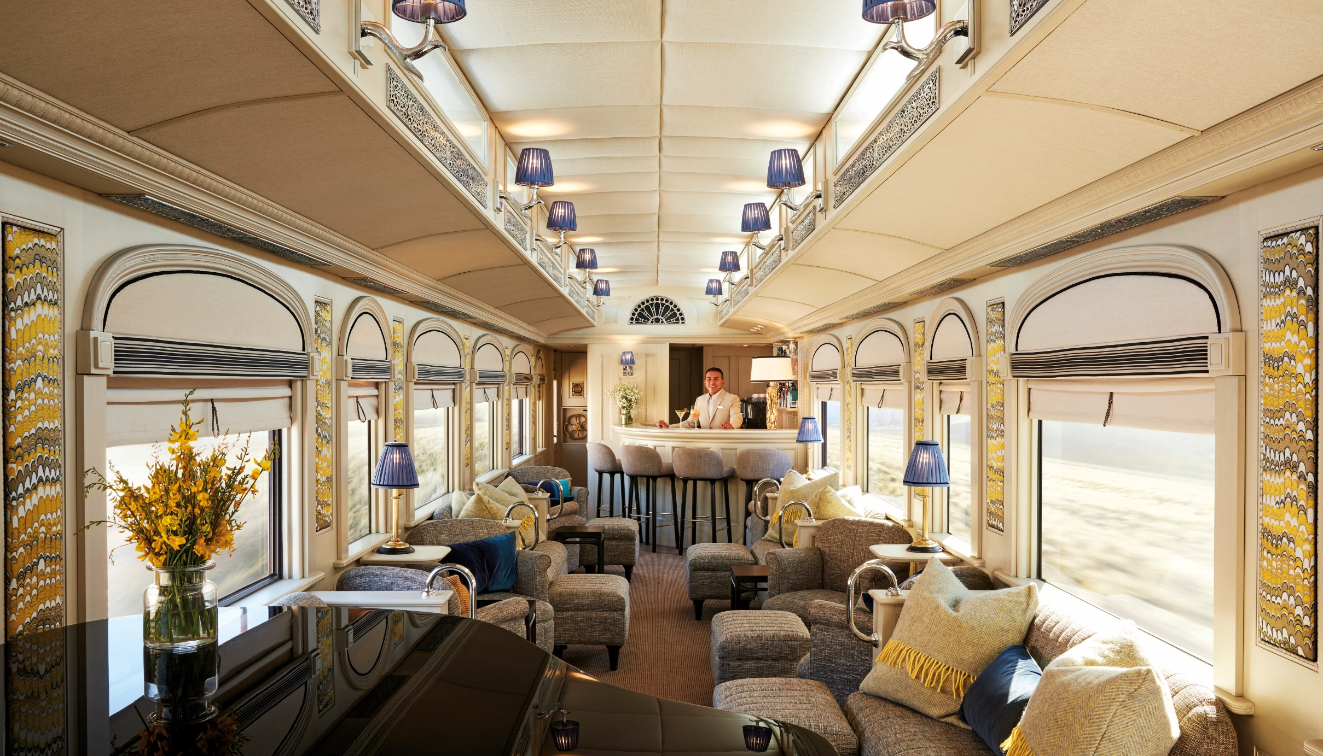
Lounge Car.
The train’s indoor hub, named after the Maca root, sports an elegant grand piano. It draws guests in with the promise of live music and the occasional sing-along. At the opposite end of the carriage to the bar is a public lavatory.
20 pax comfortable seating, 8 pax casual seating.

Slide 17
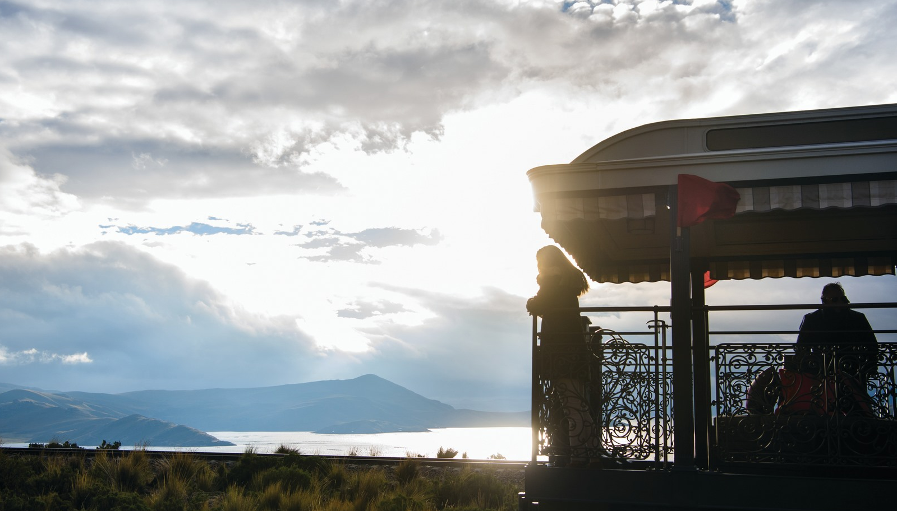
Observation Bar Car.
The ultimate spot to unwind and let the world pass you by. Enjoy the enchanting views while sipping on a Pisco Sour from the bar.
Enclosed saloon: 18 pax / Open deck área: 8 pax seating, 20 pax standing.

Slide 18
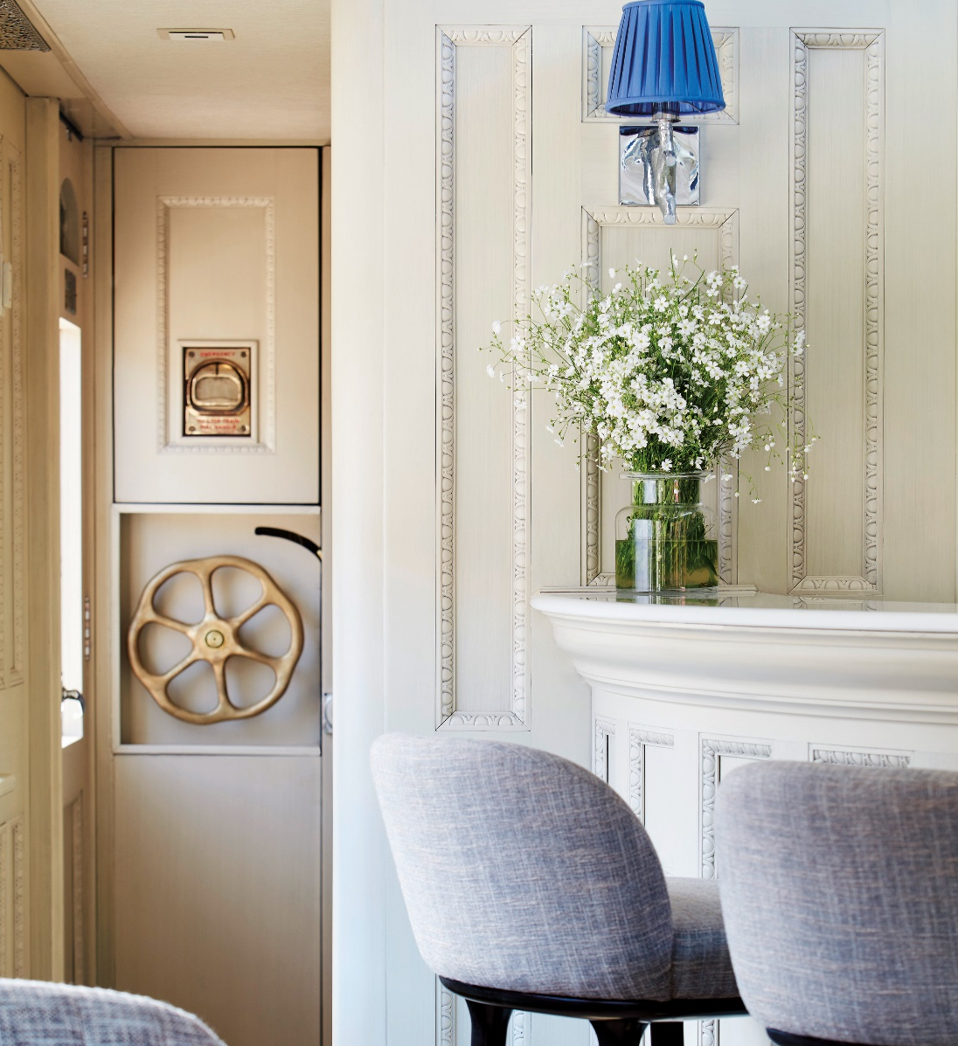
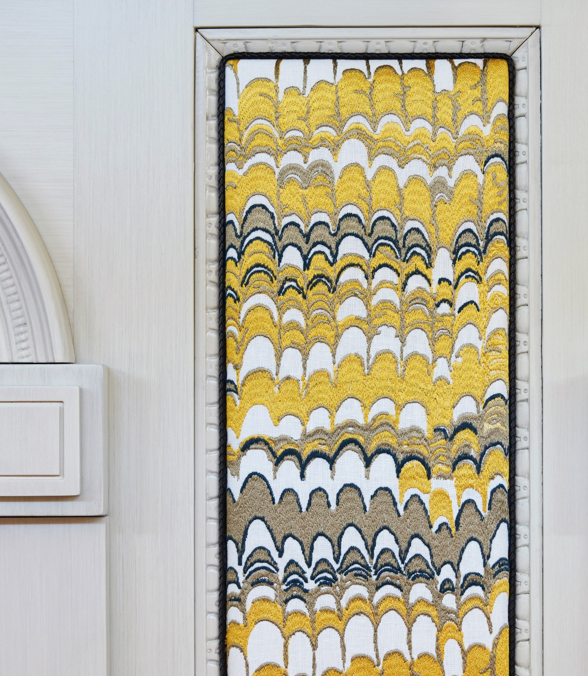
Observation Bar Car.

Slide 19
Gastronomy on board.

Slide 20
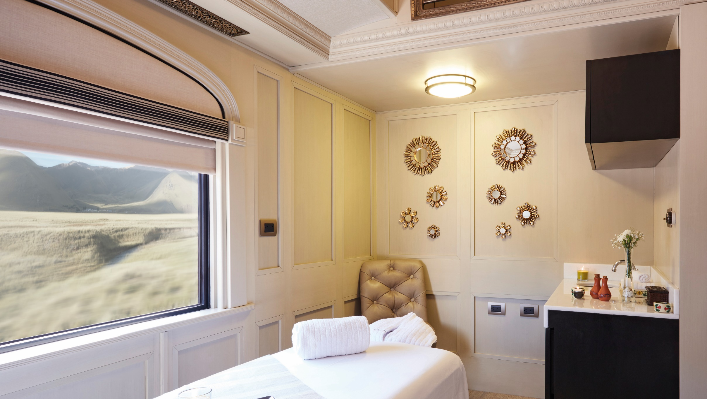
Spa.
Unwind in our sumptuous Picaflor Spa Car and enjoy luxurious treatments as you glide through spectacular Andean landscapes. Choose from an exceptional menu of therapies specially selected to enhance your Peruvian.
Please note: Our spa service is currently suspended.

Slide 21
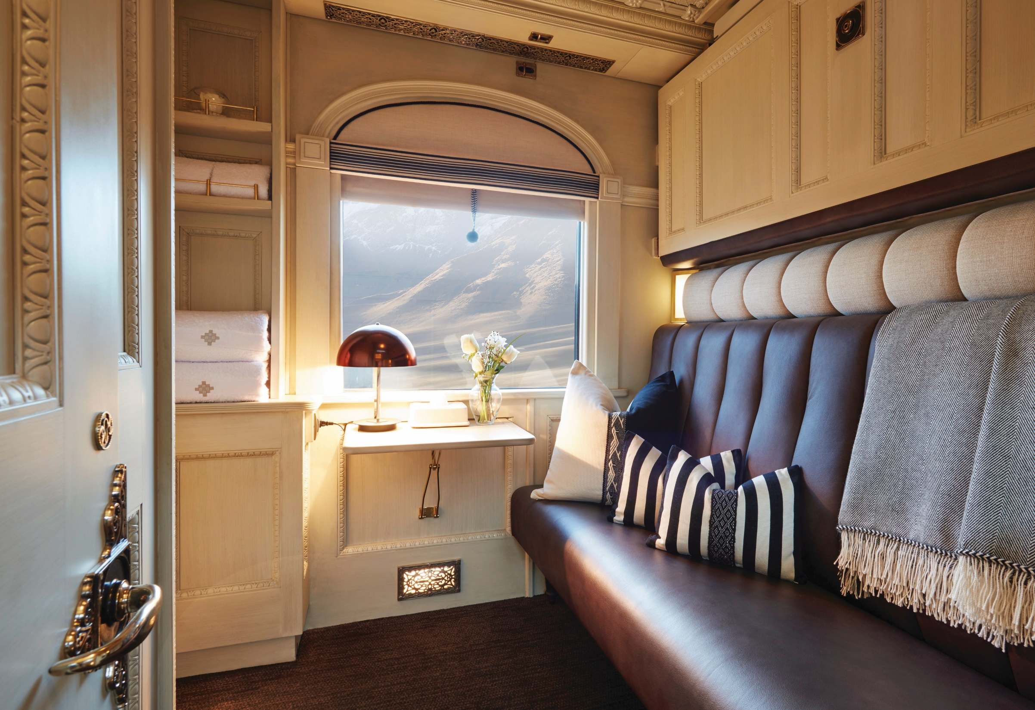
Accommodation.
In contrast to the striking landscape that glides past, each twin or double cabin offers a soothing blend of signature Peruvian accents and in-built oxygen for additional comfort at high altitudes. Hand-woven fabrics and soft, Alpaca-style textures invite a leisurely rest. An en suite bathroom and shower permit luxurious bathing––even at 4,000ft.

Slide 22
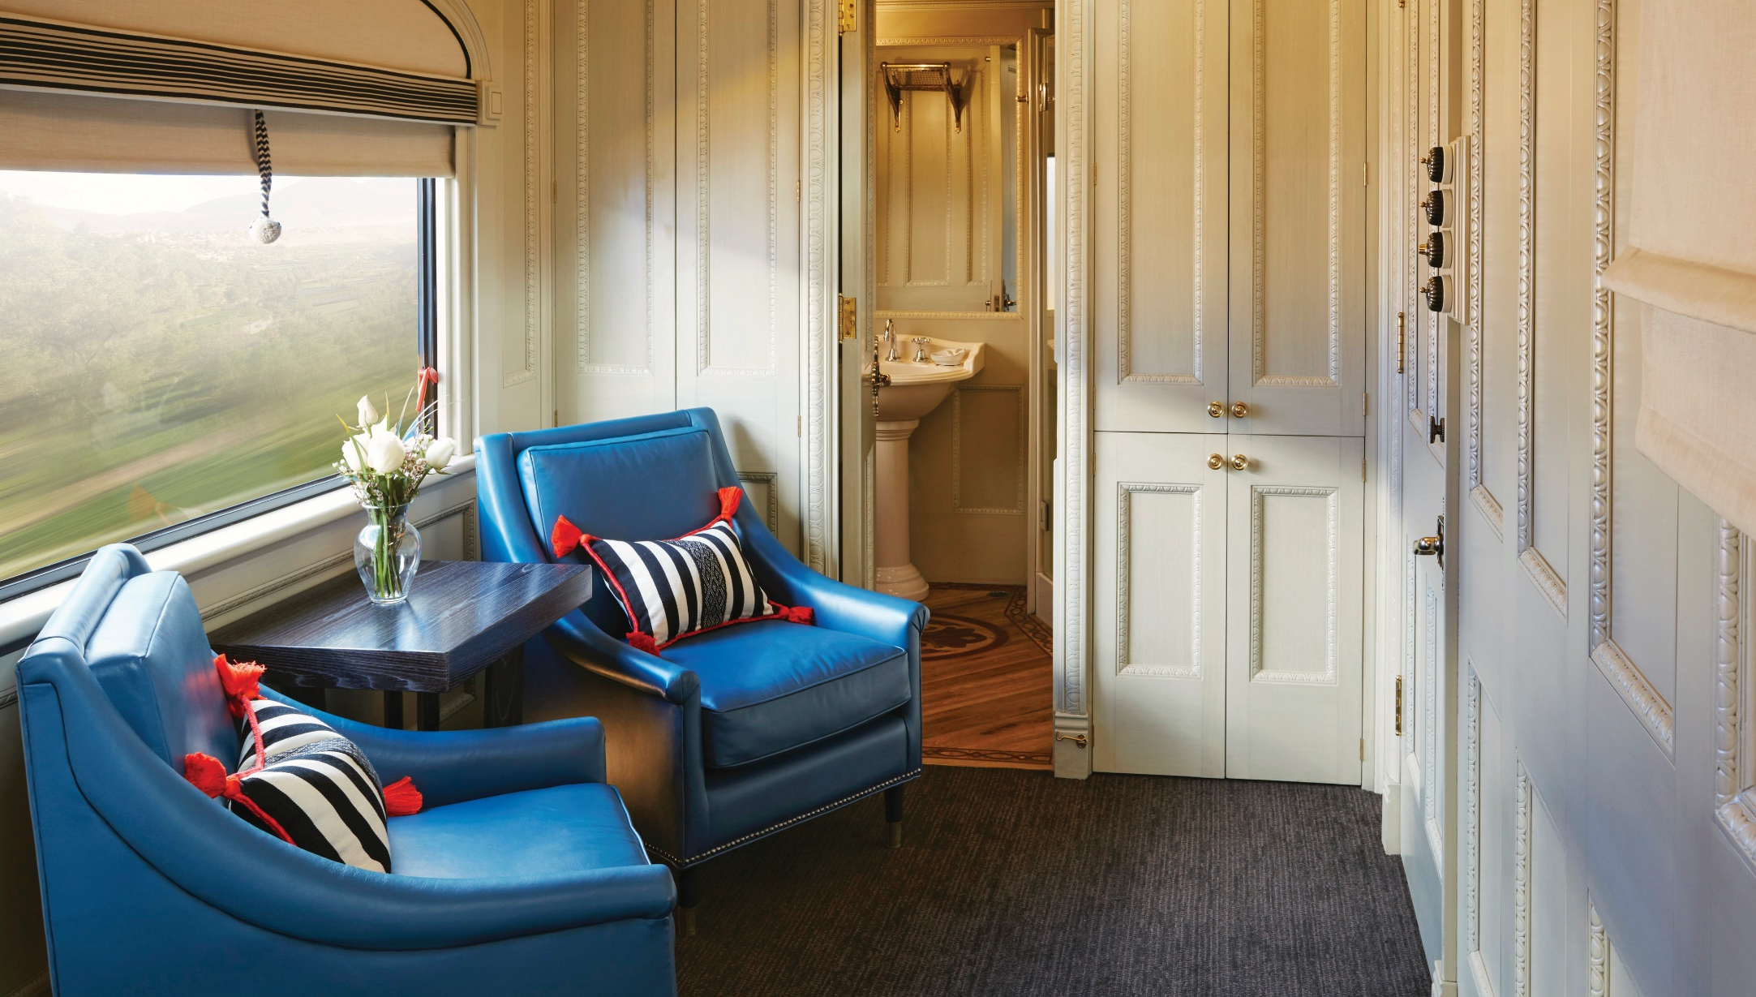
Accommodation.
The Andean Explorer has three cabin types:
Suite Cabins, Twin Bed Cabins and Bunk Bed Cabins

Slide 23
Bunk Bed Cabin.

Slide 24
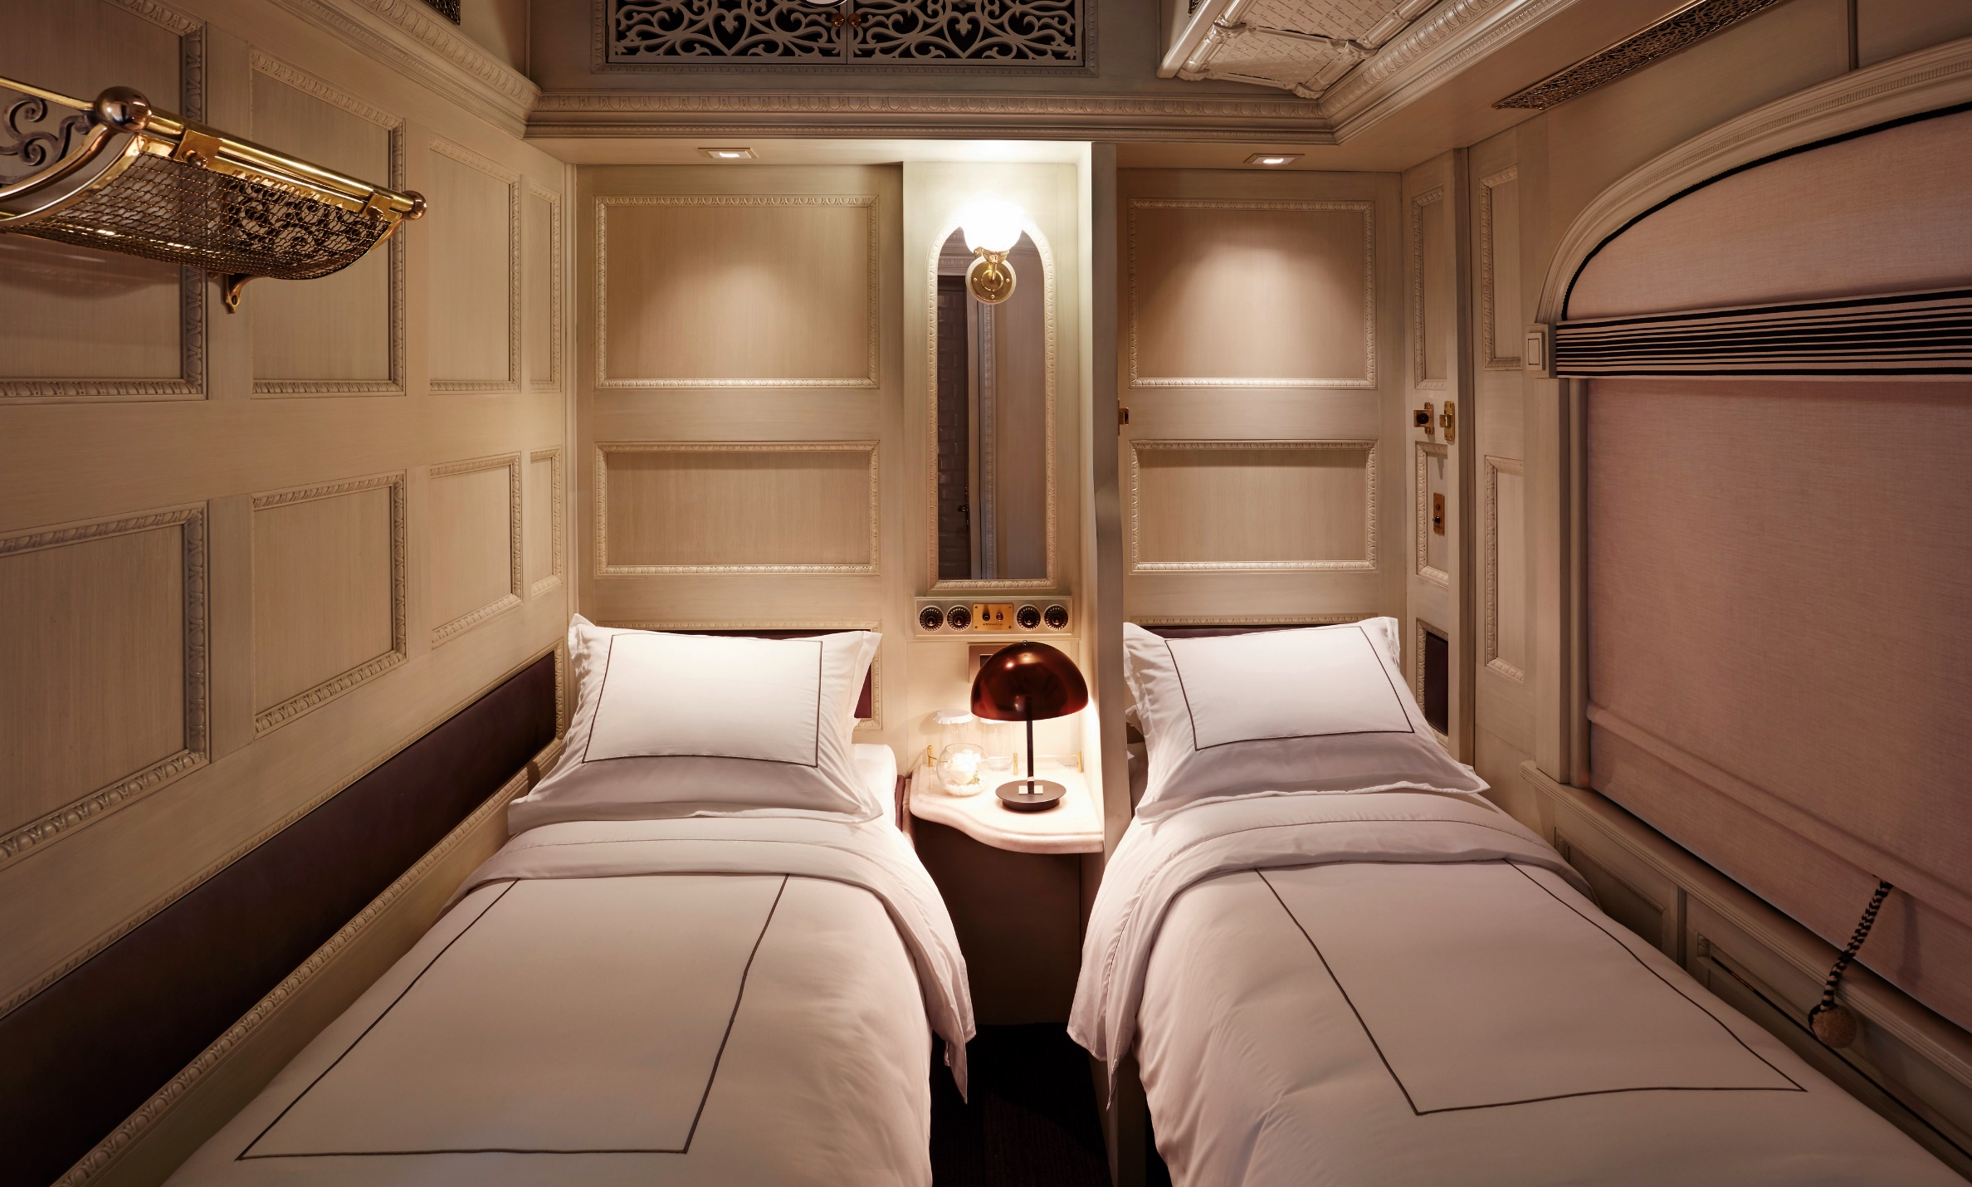
Twin Bed Cabin.

Slide 25
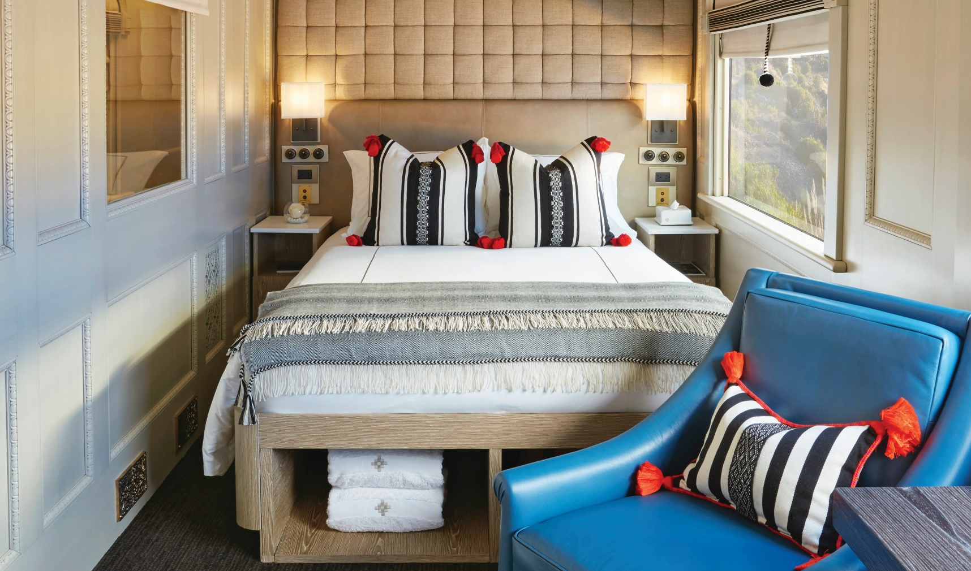
Deluxe Double Bed Cabin.

Slide 26
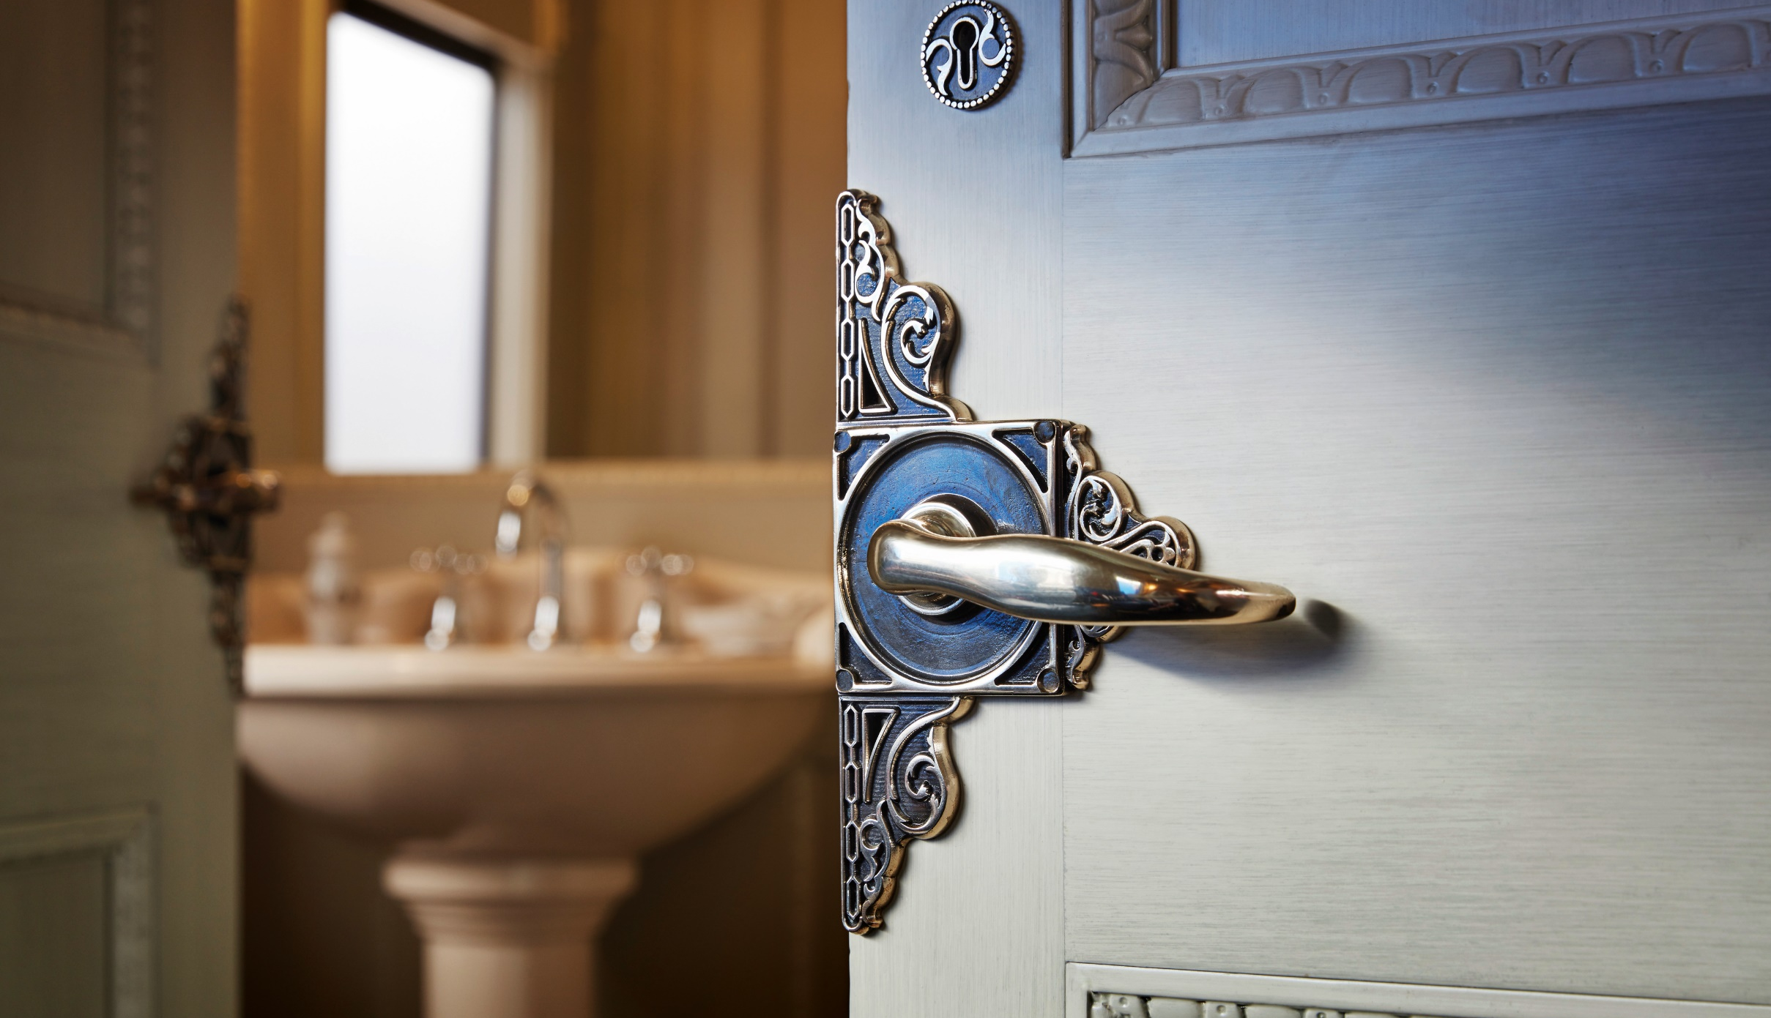
Bathroom.

Slide 27
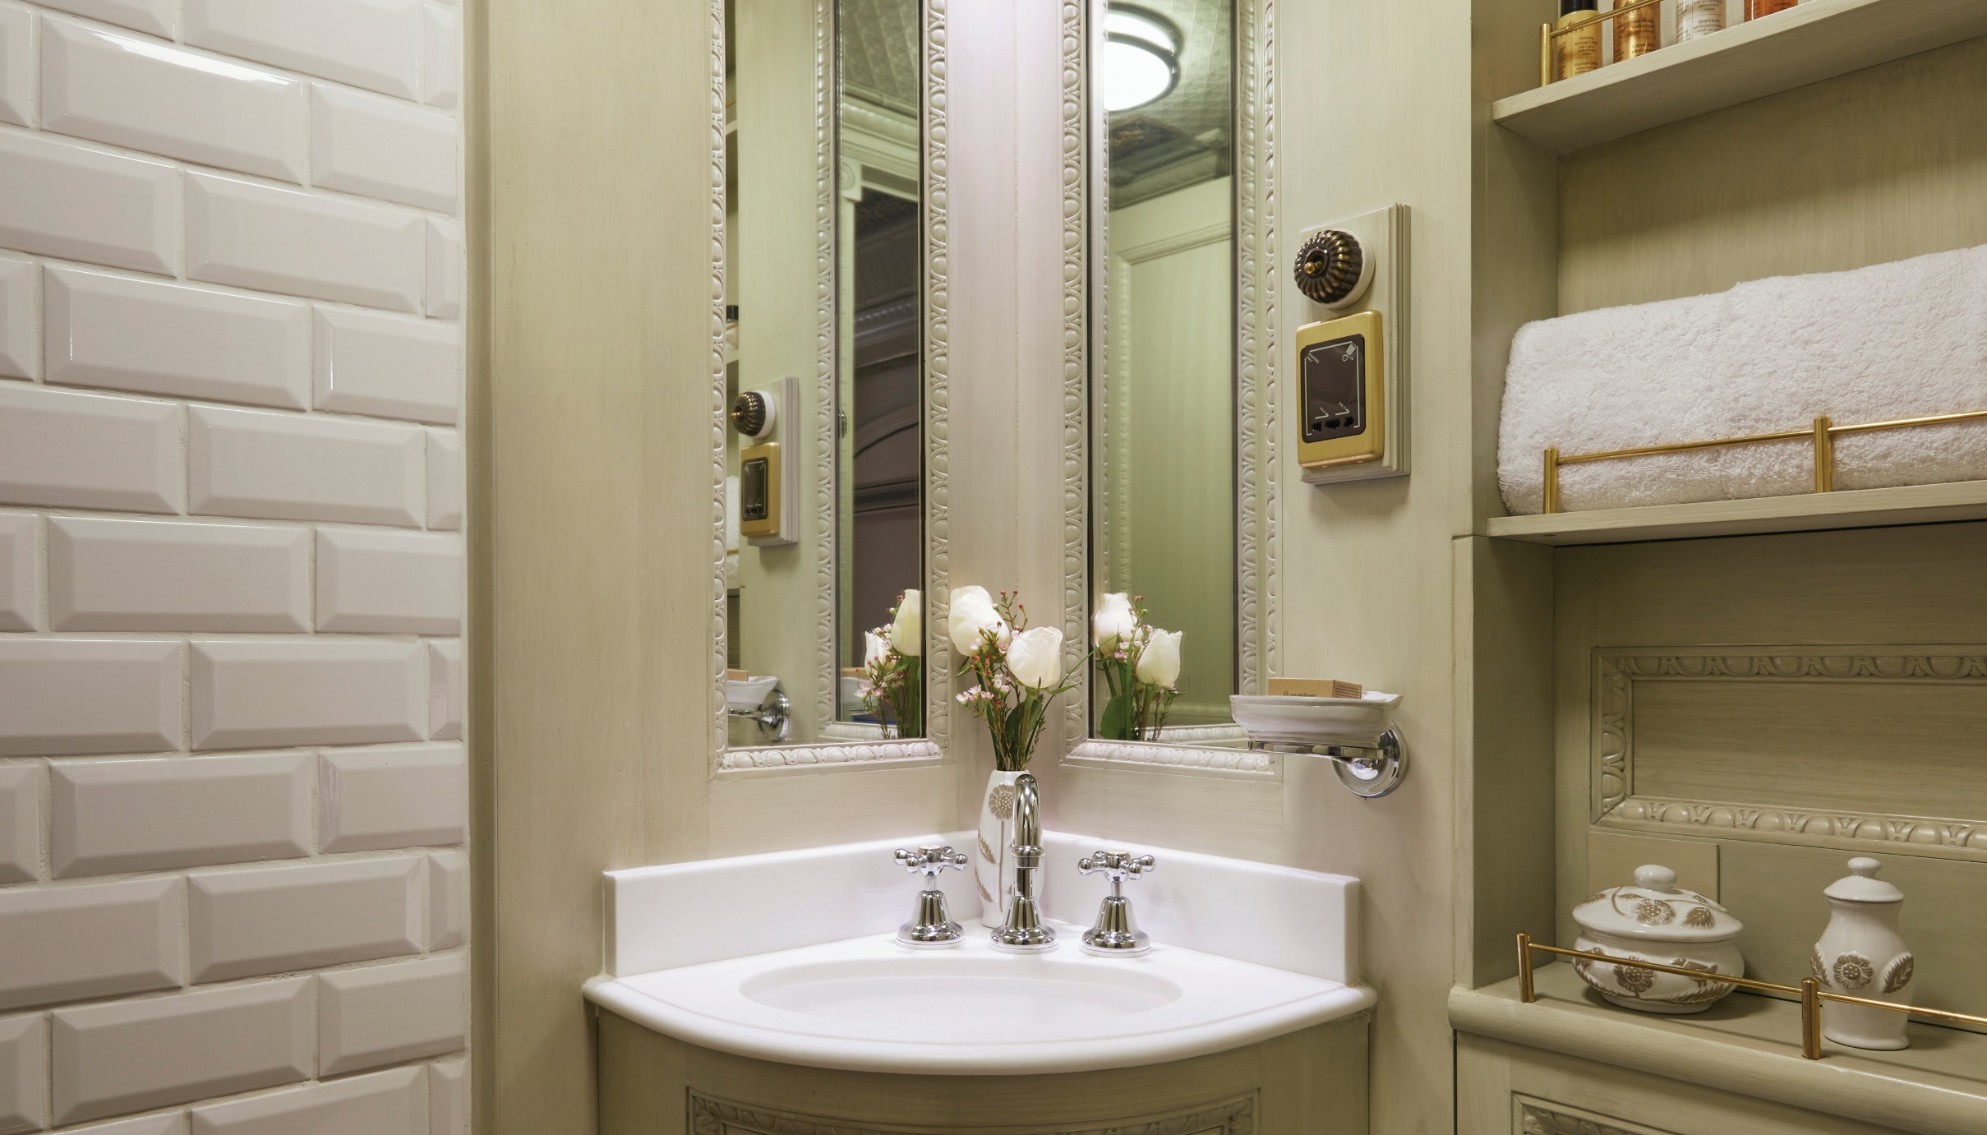
Bathroom.

Slide 28
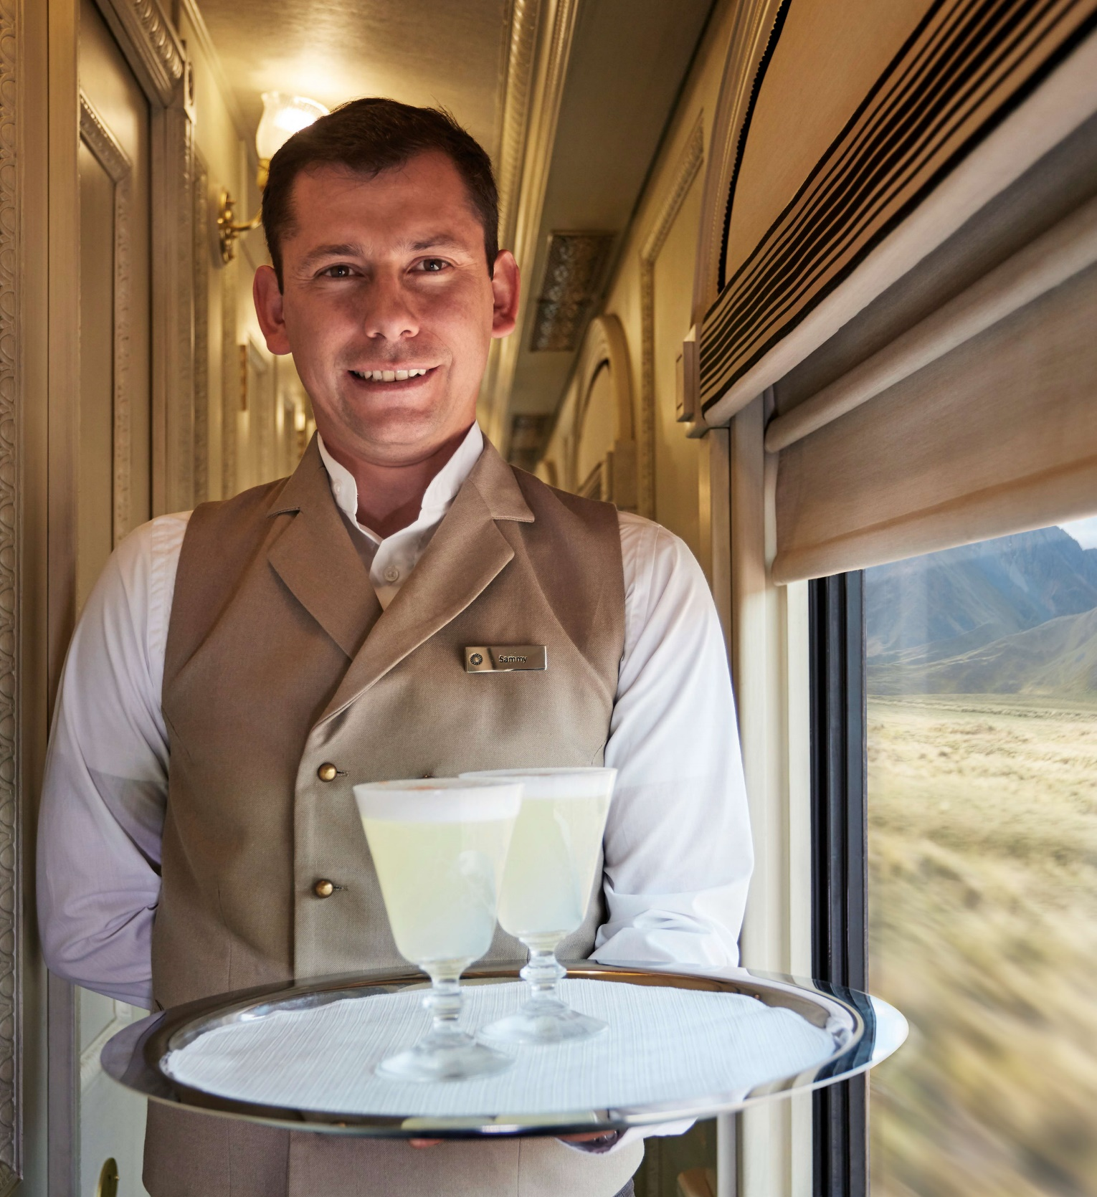
LET OUR WORK SPEAK FOR US
info@metropolitan-touring.com.pe
www.metropolitan-touring.com.pe
/metropolitantouringperu @metropolitantouringperu

